Slide 1
Virtual Assistant A.I.S.H.A : Artificial Intelligence Simulated Humanoid Assistant
Submitted to : Er. Tanu Dhiman Submitted by:
Kumar Arjun (18BSC15554), Ojas Bhimta(18BCS1569),
Abhi Pathania(18BCS1574), Danish Mehra (18BCS1564)

Slide 2
Contents
Introduction
Literature Review
Methodology
Implementation
Results and Discussion
Conclusion
Future Enhancements
References

Slide 3
Introduction
A.I.S.H.A : artificial intelligence simulated humanoid assistant. This voice-enabled virtual assistant can do a sentiment analysis of a particular user based on training data sets. Users can train this voice assistant by themselves with voice commands. This voice-enabled virtual assistant is also capable of doing basic operations. For sentimental analysis, this assistant uses a basic algorithm to identify the emotions of the user.

Slide 4
Literature Review
Various voice assistants like Google personal assistant, Siri, and Cortana are in the market. These assistants can perform multiple tasks and operations based on global set standards for dependent variables. These voice-enabled virtual assistants can do basic operations and have many basic features but fail in emotion detection and sentiment analysis.
In the Python programming language, a library named N.L.T.K. library is used for sentiment analysis.

Slide 5
Methodology
The features of this voice-enabled virtual assistant can be categorized into three categories:
Basic Operation
Training Mode
Testing Mode

Slide 6
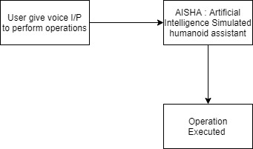
Basic Operation

Slide 7
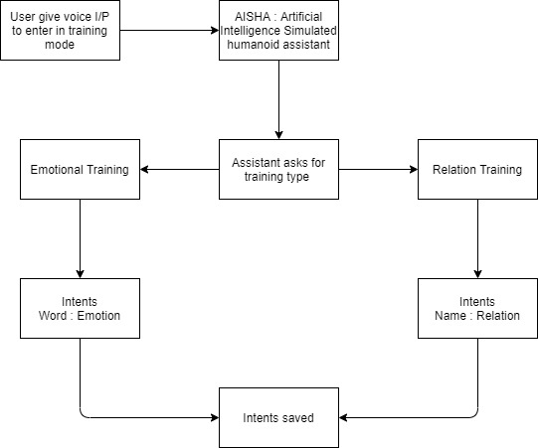
Training Mode

Slide 8
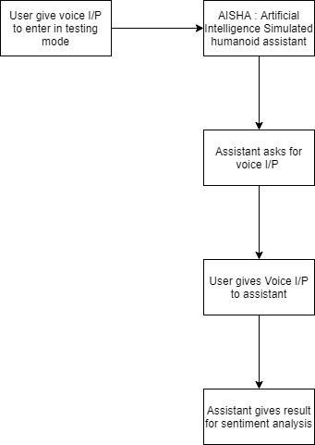
Testing Mode

Slide 9
Implementation
N.L.P. Emotion Algorithm
# 1) Check if the word in the final word list is also present in emotion.txt
# - open the emotion file
# - Loop through each line and clear it
# - Extract the word and emotion using split
# 2) If word is present -> Add the emotion to emotion_list
# 3) Finally count each emotion in the emotion list

Slide 10
Results and Discussion
The result of the sentimental analysis of the voice input given by the user was satisfying. The assistant produced the list of all emotions and sentiments associated with the user's voice input. But 100% accuracy has not been achieved. The analysis of sentiments and emotion is based on the intents saved in the module. Users have to train the model properly before using the testing mode. The leading cause of the error that causes failure in achieving 100% accuracy is distortion or interruption in voice commands. The model also depends upon the training given by the user. This assistant requires high-speed internet connectivity for better text to speech conversions.

Slide 11
Conclusion
Voice-enabled virtual assistants are one of the best applications of artificial intelligence and machine learning. This paper discusses the basic algorithm used for sentiment analysis of individual users. This paper also concerns the methodology and implementation of this voice-enabled virtual assistant to understand the results sufficiently. Due to voice interruption and training errors, it misses achieving 100% accuracy. We can attain 100% accuracy if the individual user itself trains the model, and there is no interruption in the voice input.

Slide 12
Future Enhancements
Our goal was to achieve 100% accuracy. To achieve 100% accuracy in the future, there must be some advancement and modification in text to speech API and training algorithms. In the end, this voice-enabled virtual assistant can be used as a lifesaver. If the user feels demotivated or stressed, it can send SMS to inform the close relatives or friends from the intents saved in relation training. This voice assistant can also be used for or reporting the closed one in social circles about the user's present emotion and sentiment.

Slide 13
References
[1] "AI Based Voice Assistant Using Python", International Journal of Emerging Technologies and Innovative Research (www.jetir.org), ISSN:2349-5162, Vol.6, Issue 2, page no.506-509, February-2019, Available :http://www.jetir.org/papers/JETIR1902381.
[2] Artificial intelligence (AI), sometimes called machine intelligence. https://en.wikipedia.org/wiki/Artificial_intelligence
[3] B. Marr, The Amazing Ways Google Uses Deep Learning AI..
[4] Cortana Intelligence, Google Assistant, Apple Siri.
[5] Hill, J., Ford, W.R. and Farreras, I.G., 2015. Real conversations with artificial intelligence: A comparison between human–human online conversations and human–chatbot conversations. Computers in Human Behavior, 49, pp.245-250.
[6] K. Noda, H. Arie, Y. Suga, T. Ogata, Multimodal integration learning of robot behavior using deep neural networks,
Elsevier: Robotics and Autonomous Systems, 2014.
[7] "CMUSphnix Basic concepts of speech - Speech Recognition process".
http://cmusphinx.sourceforge.netlwiki/tutorialconcepts

